Slide 1

Reasonably Exhaustive Research

Slide 2

Your Image and Comments are Part of the Recorded Program
Recordings Will Be Available on the
GTV Academy Platform ASAP

Slide 3

Recording of this presentation is prohibited
Constance Henley Knox © 2023

Slide 4


Welcome
New Members
So Glad You’re Here

Slide 5
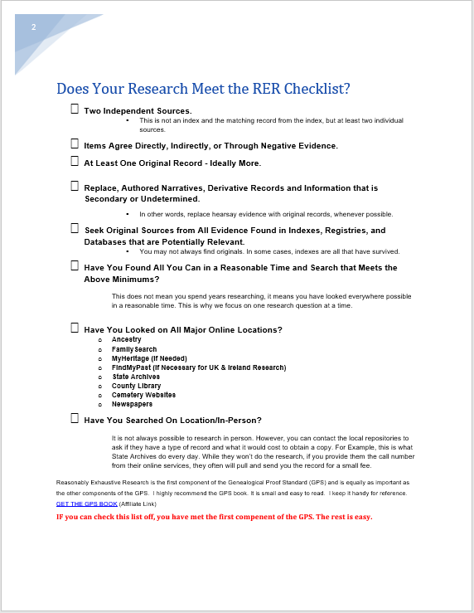
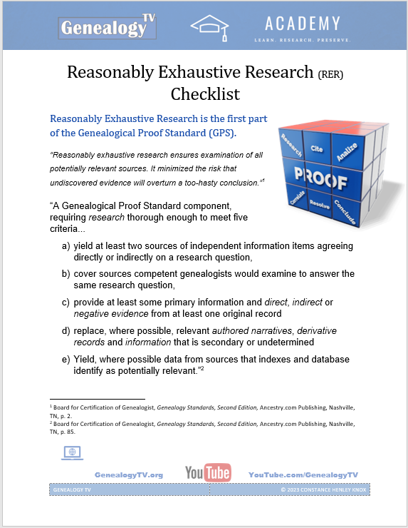
HANDOUT!
In the Chat and in the Materials Section in the Genealogy TV Academy Lesson

Slide 6

Announcements
Ask Questions
in Chat or
Hold Until the End
Ashley is Moderating the Chat

Slide 7
What is it and how can we apply this strategy?
Reasonably Exhaustive Research
Genealogical Proof Standard #1

Slide 8
Because...
Why?
Reasonably Exhaustive Research
Genealogist Copy Errors
Omissions
Memories Fade
Family Mislead
Clerk Mistakes
Missing Puzzle Pieces

Slide 9

Why Teach This?
Reasonably Exhaustive Research

Slide 10
It’s not Exhausting...
It’s Fun!
Reasonably Exhaustive Research
Genealogical Proof Standard #1

Slide 11
It’s not Exhausting...
It’s Fun!
Reasonably Exhaustive
Thorough Research
Genealogical Proof Standard #1

Slide 12
5 Elements of the
GPS
5 Elements
of the
RER
Reasonably Exhaustive Research
Genealogical Proof Standards

Slide 13
5 Elements of the GPS
2 Source Citations
3 Analysis & Correlation
4 Conflict Resolution
5 Written Conclusion
1 Reasonably Exhaustive Research
Genealogical Proof Standards

Slide 14
5 Elements of the
GPS
#1 Reasonably Exhaustive Research
#2 Complete and Accurate Source Citations
#3 Testing through Evidence Analysis and Correlation of Evidence
#4 Conflict Resolution
#5 Soundly Reasoned, Coherently Written Conclusions
Genealogical Proof Standards

Slide 15
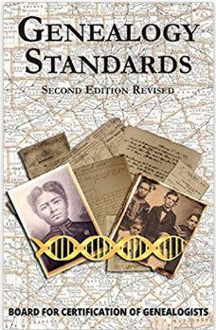
#1
Reasonably Exhaustive Research
“Reasonably exhaustive research ensures examination of all potentially relevant sources. It minimized the risk that undiscovered evidence will overturn a too-hasty conclusion.”
Board for Certification of Genealogist, Genealogy Standards, Second Edition, Ancestry.com Publishing, Nashville, TN, p. 2.
Genealogy Standards, 2nd Edition

Slide 16
Reasonably Exhaustive Research
“A Genealogical Proof Standard component, requiring research thorough enough to meet five criteria...
yield at least two sources of independent information items agreeing directly or indirectly on a research question,
cover sources competent genealogists would examine to answer the same research question,
provide at least some primary information and direct, indirect or negative evidence from at least one original record
replace, where possible, relevant authored narratives, derivative records and information that is secondary or undetermined
Yield, where possible data from sources that indexes and database identify as potentially relevant.”
Board for Certification of Genealogist, Genealogy Standards, Second Edition, Ancestry.com Publishing, Nashville, TN, p. 85.

Slide 17
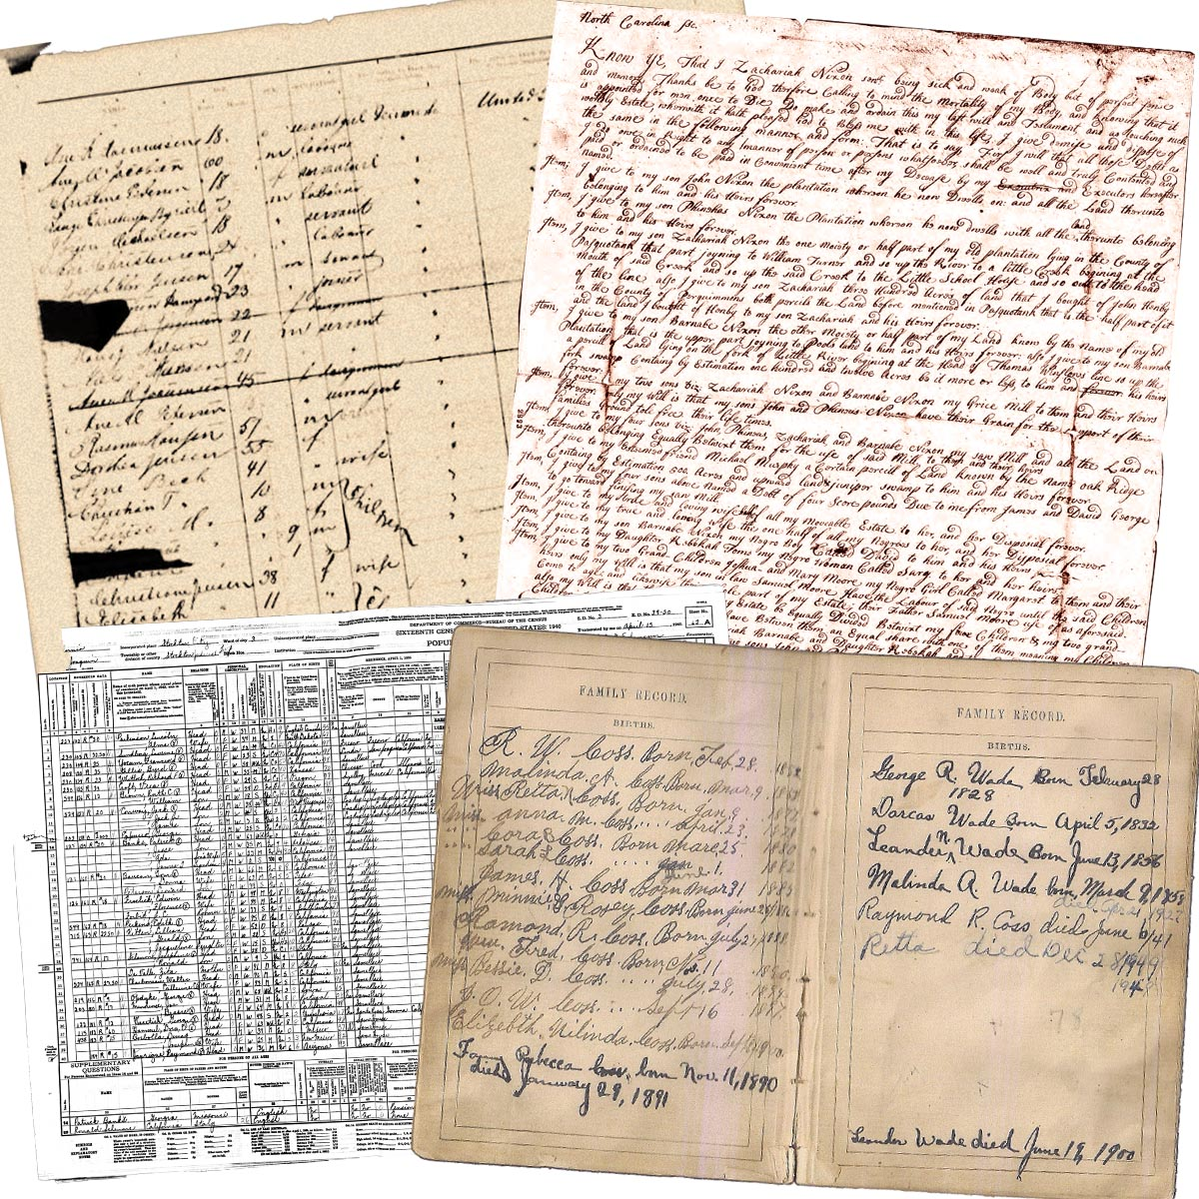
Reasonably Exhaustive Research
a) yield at least two sources of independent information items agreeing directly or indirectly on a research question,
A Fact or Collection of Facts
Board for Certification of Genealogist, Genealogy Standards, Second Edition, Ancestry.com Publishing, Nashville, TN, p. 85.

Slide 18

Reasonably Exhaustive Research
a) yield at least two sources of independent information items agreeing directly or indirectly on a research question,
A Fact
Board for Certification of Genealogist, Genealogy Standards, Second Edition, Ancestry.com Publishing, Nashville, TN, p. 85.

Slide 19
Reasonably Exhaustive Research
a) yield at least two sources of independent information items agreeing directly or indirectly on a research question,
Date and Place
A Fact
Date
Place
Board for Certification of Genealogist, Genealogy Standards, Second Edition, Ancestry.com Publishing, Nashville, TN, p. 85.

Slide 20
Reasonably Exhaustive Research
b) cover sources competent genealogists would examine to answer the same research question,
Depending on the Research Question...
All Possible
Records
Seek
Original Records

Slide 21
Reasonably Exhaustive Research
c) provide at least some primary information and direct, indirect or negative evidence from at least one original record
Primary Evidence = First-hand or Eyewitness to a Fact.
Secondary (Derivative) Evidence = Another Person is Reporting on a Fact.

Slide 22
Reasonably Exhaustive Research
c) provide at least some primary information and direct, indirect or negative evidence from at least one original record
Direct Evidence = Directly answers the Research Question
Indirect Evidence = Answers the Research Question in combination with other evidence.
Negative Evidence = Someone or record is not found where it is expected.

Slide 23
Direct Evidence = Directly answers the Research Question
When did John Doe die?
Death Certificate
with Death Date and Place
Obituary
with Death Date and Place
Matching Information
“yield at least two sources of independent information items agreeing directly...”

Slide 24
Indirect Evidence = Answers the Research Question in combination with other evidence.
When did John Doe die? (Hypothetical Question)
A new looking tombstone found on Find A Grave, says John Doe lived from 1846 – 1881.
Daily Diary of Elizabeth Doe, with dated April 2nd, 1882, passage talking about “today was a lovely spring day” for her father’s funeral. Diary is privately held by a descendant of John Doe. Other dated entries leading up to his death talk about his illness. Does not name father.
1880 Census stated the relationship to John Doe (HOH) as wife Beth and his daughter Elizabeth.
Widows Civil War Pension Papers, filed in 1890, with a testimony from his surviving wife Beth, that he died in the spring of 1881.
Newspaper article from April 4th, 1882, with a comment that the weather has been splendid over the last few days and is expected to continue.
Newspaper article form April 4th, 1881, reports flooding in the area with rain expected to continue.

Slide 25
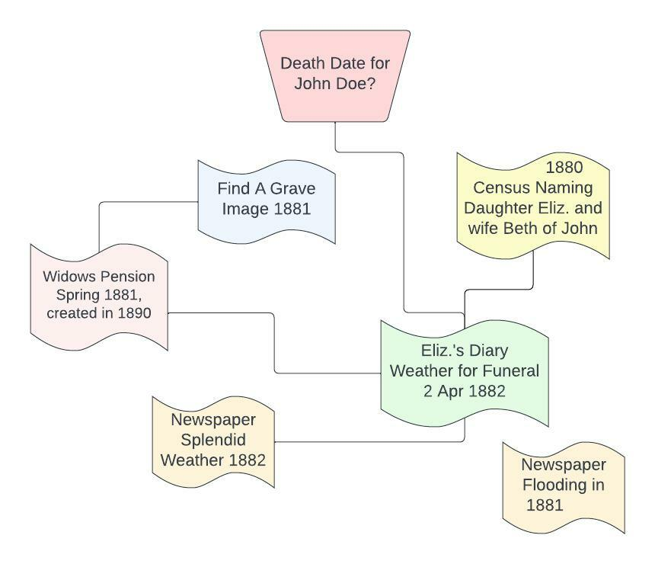
Indirect Evidence = Answers the Research Question in combination with other evidence.
When did John Doe die?
A new looking tombstone found on Find A Grave, says John Doe lived from 1846 – 1881.
Daily Diary of Elizabeth Doe, with dated April 2nd, 1882, passage talking about “today was a lovely spring day” for her father’s funeral. Diary is privately held by a descendant of John Doe. Other dated entries leading up to his death talk about his illness. Does not name father.
1880 Census stated the relationship to John Doe (HOH) as wife Beth and his daughter Elizabeth.
Widows Civil War Pension Papers, filed in 1890, with a testimony from his surviving wife Beth, that he died in the spring of 1881.
Newspaper article from April 4th, 1882, with a comment that the weather has been splendid over the last few days and is expected to continue.
Newspaper article form April 4^{th,} 1881, reports flooding in the area with rain expected to continue.

Slide 26
Indirect Evidence
When did John Doe die?

Slide 27
Negative Evidence
“Information is absent amid a set of circumstances where it could be expected.”*
“A researcher uses that absence to understand an identity, relationship, status or event.”
A Real Story
The Summerlin family in 1910
Walter Knox – 30 (HOH)
Mamie Knox – 27, Wife
Blanche Knox – 6, Daughter
Fannie Knox – 4, Daughter
Mattie Knox – 2, Daughter
Walter T. Knox – 0, Son
The Summerlin family in 1920
Walter H. Knox – 40 (HOH)
Mamie Knox – 35, Wife
Nellie B. Knox – 15, Daughter
Mattie Neil Knox – 13, Daughter
Walter T. Knox – 11, Son
William C – 7, Son
John A. – 7, Son
Robert V. 10/12, Son
?
Who is missing?
Fannie Knox
*Professional Genealogy, Preparation, Practice, & Standards – Elizabeth Shown Mills, Editor

Slide 28
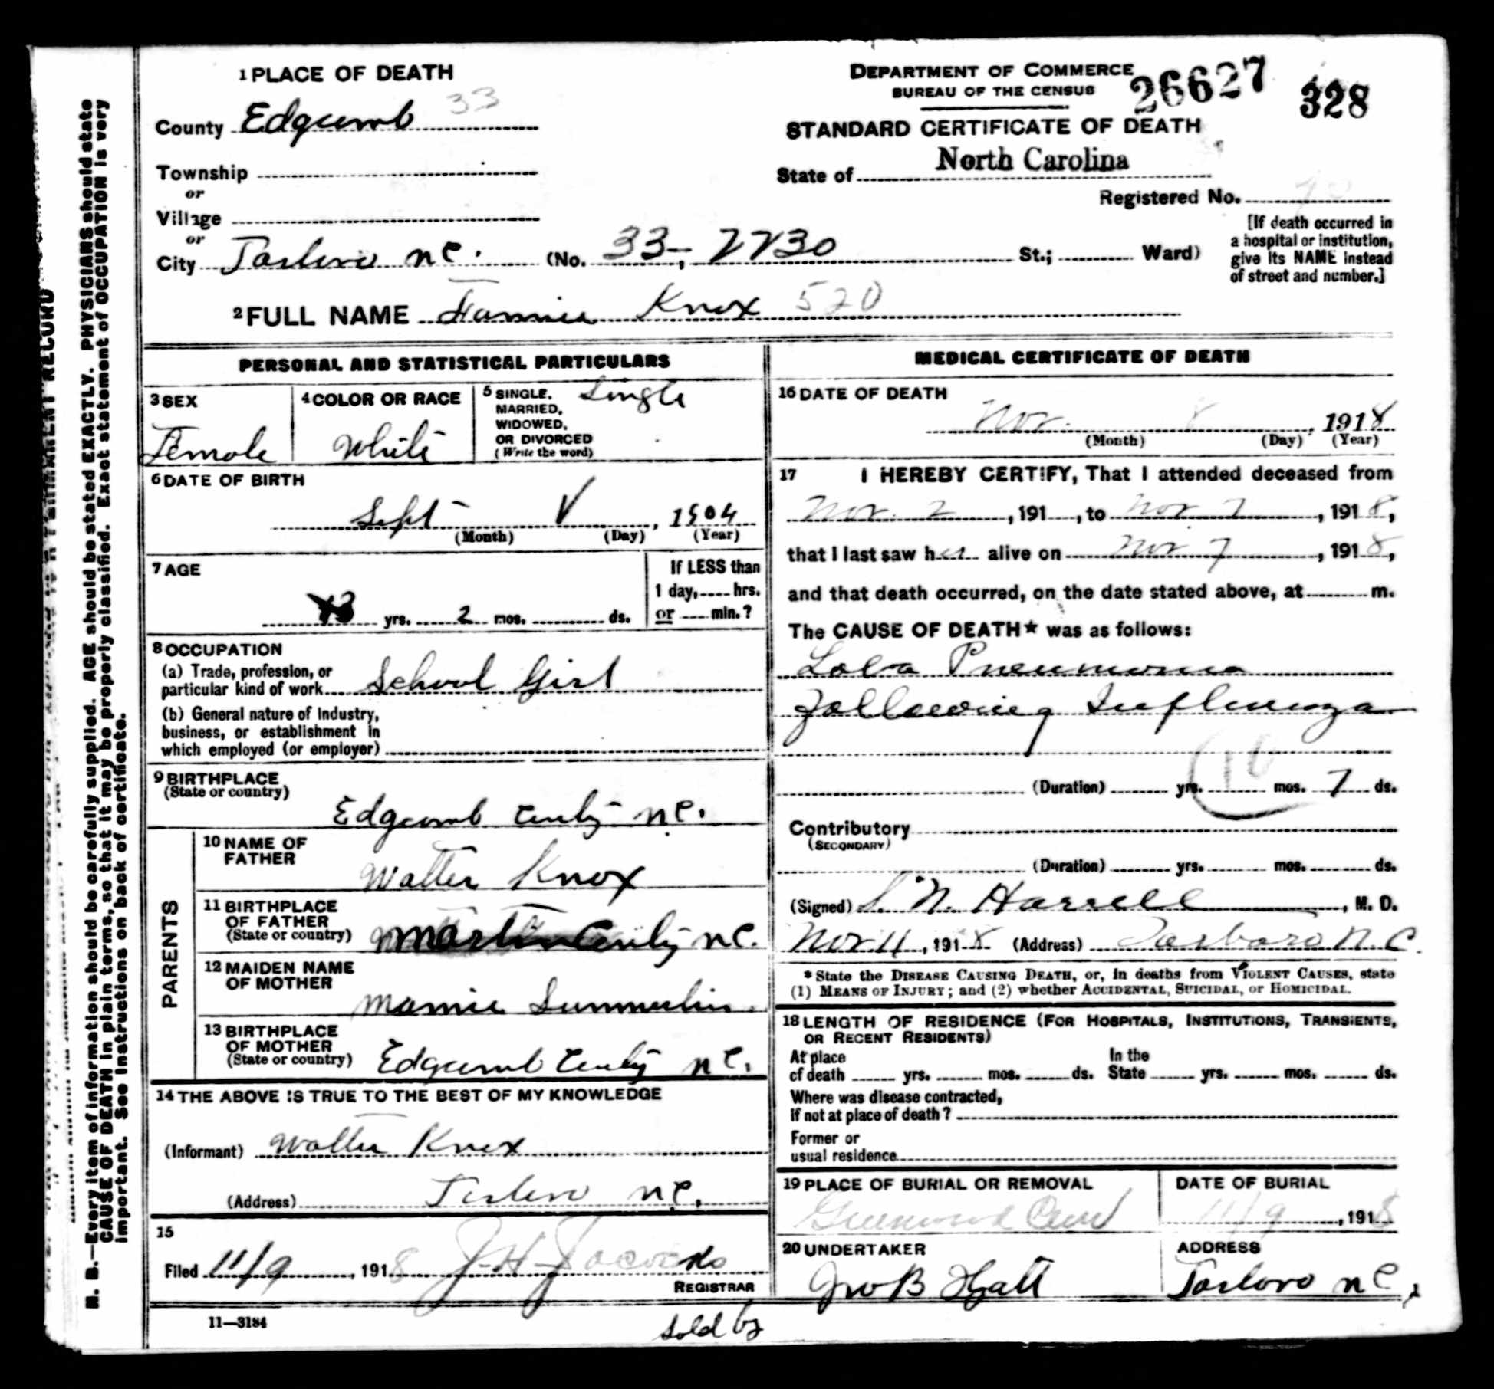
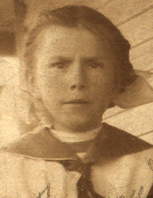

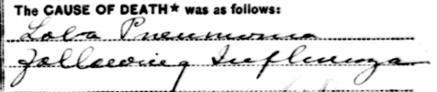
Negative Evidence
Flu Epidemic 1918
Fannie Knox
*Professional Genealogy, Preparation, Practice, & Standards – Elizabeth Shown Mills, Editor

Slide 29
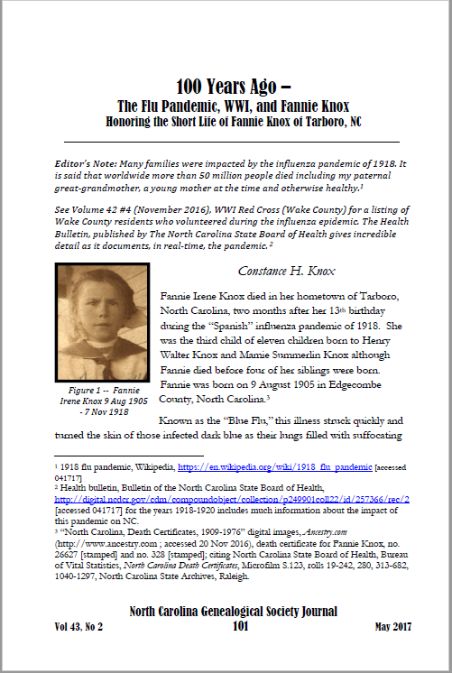
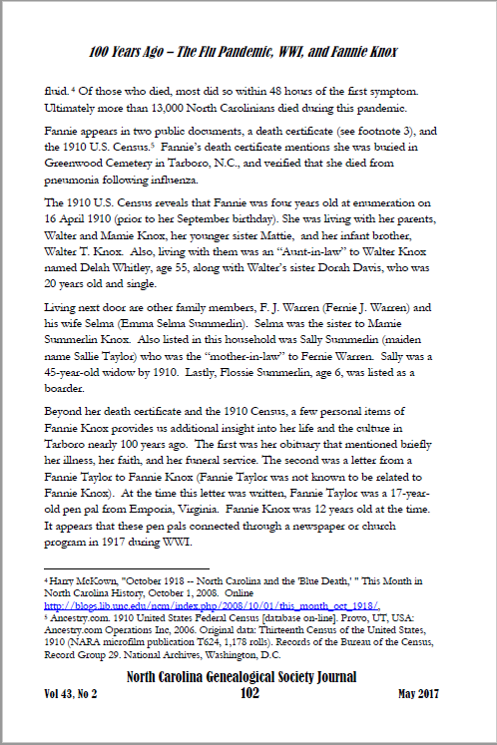
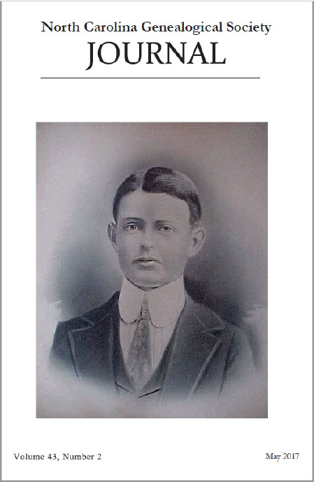
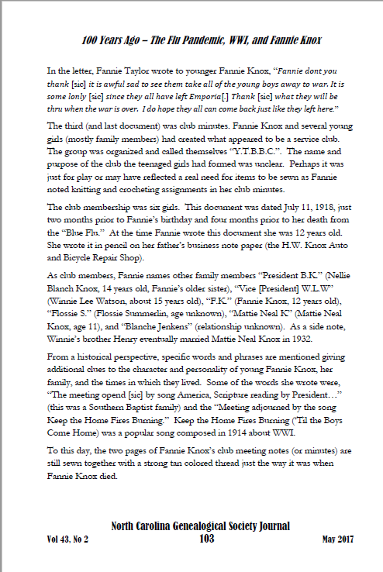
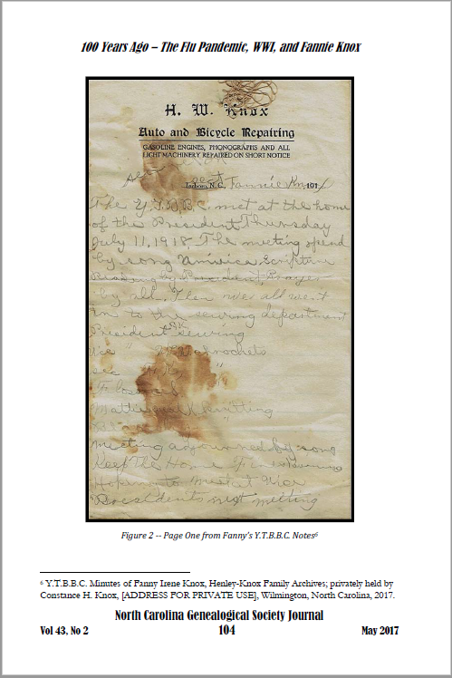
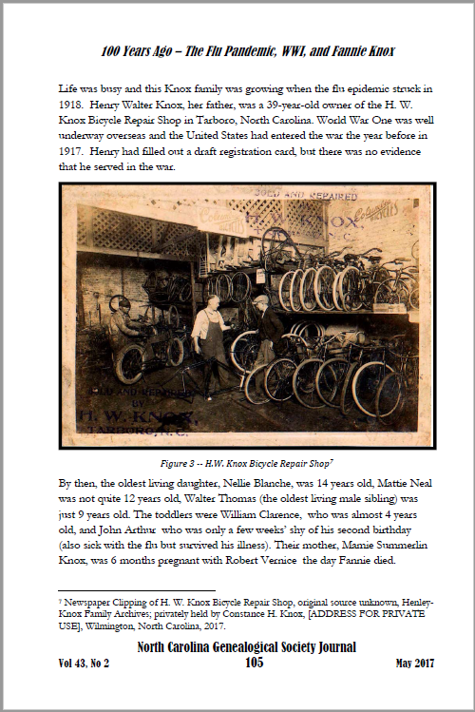
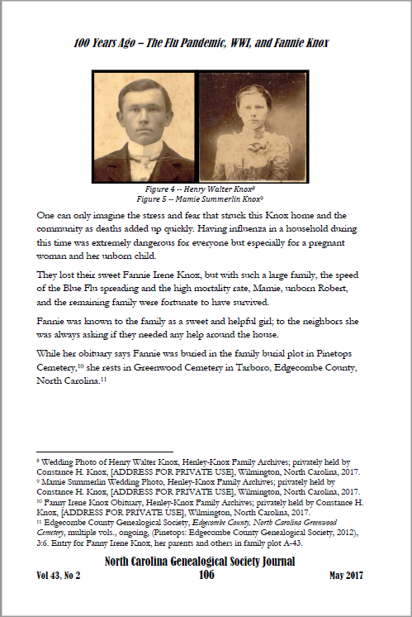
NC Genealogical Society Journal, May 2017, Vol. 43, No. 2, p. 101-106

Slide 30
Reasonably Exhaustive Research
d) replace, where possible, relevant authored narratives, derivative records and information that is secondary or undetermined
Authored Narratives = Books, Manuscripts, Family Histories, etc.
Derivative Records = Copies, Indexes, Registries, Clerk Copies
Secondary Information = Anything being reported by another or hearsay evidence.
Board for Certification of Genealogist, Genealogy Standards, Second Edition, Ancestry.com Publishing, Nashville, TN, p. 85.

Slide 31
Reasonably Exhaustive Research
e) yield, where possible data from sources that indexes and database identify as potentially relevant.”
“All findable sources that relevant sources and indexes suggest. When a source, database, or index suggests a source is relevant to our search—a death certificate indicated by a death index, for example, or court minutes or a case file implied by a deed’s wording—we try to locate the source. If it is available, we examine it. We are not satisfied with references to our sources, because they usually provide fewer, if not less-accurate, information items than the source itself.” -Thomas W. Jones
Thomas W. Jones, Mastering Genealogical Proof, National Genealogical Society, Arlington, VA, p. 26.

Slide 32

Reasonably Exhaustive Research
Let’s Get Real!
What does this really mean as we do our family history research?

Slide 33
4 point – do not delete this text – use for hyperlink
Your GPS Path.
RESEARCH
Your Plan
Reasonably Exhaustive Research
PLAN
Your Research
ANALYZE & CORRELATE
Your Documents
RESOLVE & CONCLUDE

Slide 34



As You Go Through Research Phase...
1
Research Notes
Add to your Research Notes as you Discover Records
Notes
2
Cite Your Sources
Add where you found these records in your Research Notes
You’ll thank me later!
Cite
3
Prepare for Evidence Correlation
Optional Step
Add to your Excel or Correlation Document
Prepare

Slide 35

GPS
Reasonably Exhaustive Research...
...is only one piece of the puzzle to satisfy the Genealogical Proof Standard.

Slide 36
R.E.R. Recap
“A Genealogical Proof Standard component, requiring research thorough enough to meet five criteria...
yield at least two sources of independent information items agreeing directly or indirectly on a research question,
cover sources competent genealogists would examine to answer the same research question,
provide at least some primary information and direct, indirect or negative evidence from at least one original record
replace, where possible, relevant authored narratives, derivative records and information that is secondary or undetermined
Yield, where possible data from sources that indexes and database identify as potentially relevant.”
Board for Certification of Genealogist, Genealogy Standards, Second Edition, Ancestry.com Publishing, Nashville, TN, p. 85.

Slide 37
HANDOUT!
In the Chat and in the Materials Section in the Genealogy TV Academy Lesson

Slide 38

Reasonably Exhaustive Research
Handout Checklist
Does Your Research Meet the RER Checklist?
Two Independent Sources.
Items Agree Directly, Indirectly, or Through Negative Evidence.
At Least One Original Record - Ideally More.
Replace, Authored Narratives, Derivative Records and Information that is Secondary or Undetermined.
Seek Original Sources from All Evidence Found in Indexes, Registries, and Databases that are Potentially Relevant.
Have You Found All You Can in a Reasonable Time and Search that Meets the Above Minimums?
Have You Looked on All Major Online Locations?
  Ancestry
  FamilySearch
  MyHeritage (If Needed)
  FindMyPast (If Necessary for UK & Ireland Research)
  State Archives
  County Library
  Cemetery Websites
  Newspapers
Have You Searched On Location/In-Person?

Slide 39


Next Session
Q&A
Wednesday
1/18/23
@ 3:00 PM
Questions submitted in advance are handled first, then live questions.

Slide 40

Questions?

